Slide 1
JavaScript for Interactive Web Pages
By Jinzhu Gao

Slide 2
Objectives
Learn how to program web pages on the client side using JavaScript

Slide 3
JavaScript (7.1)
A lightweight, dynamic scripting language used to implement dynamic client-side interfaces
A web standard (but not supported identically by all browsers)
NOT related to Java other than by name and some syntactic similarities
Has ability to interact with the content of a web page and change that content in response to user actions
insert dynamic text into HTML (ex: user name)
react to events (ex: page load user click)
get information about a user's computer (ex: browser type)
perform calculations on user's computer (ex: form validation)

Slide 4
JavaScript vs. Java
Interpreted, not compiled
More relaxed syntax and rules
key construct is the function rather than the class
contained within a web page and integrates with its HTML/CSS content

Slide 5
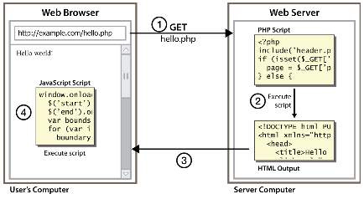
Client-Side Scripting
Code runs in browser after page is sent back from server
Notes:
often this code manipulates the page or responds to user actions

Slide 6
JavaScript vs. PHP
Similarities:
both are interpreted, not compiled
both are relaxed about syntax, rules, and types
both are case-sensitive
both have built-in regular expressions
Differences:
JS is less procedural, more object-oriented
JS focuses on user interfaces and interacting with a document; PHP is geared toward HTML output and file/form processing
JS code runs on the client's browser; PHP code runs on the web server

Slide 7
JavaScript vs. PHP
PHP benefits:
security:
Has access to server's private data; client can't see source code
compatibility:
avoids browser compatibility issues
power:
fewer restrictions (can write to files, open connections to other servers, connect to databases, ...)
JavaScript benefits:
usability:
can modify a page without having to post back to the server (faster UI)
efficiency:
can make small, quick changes to page without waiting for server
event-driven:
can respond to user actions like clicks and key presses

Slide 8
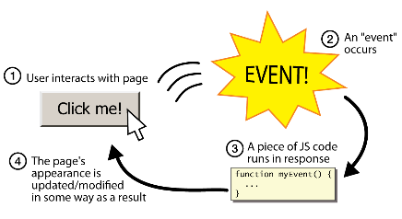
Event-Driven Programming
JavaScript programs wait for user actions called events and respond to them
Notes:
event-driven programming: writing programs driven by user events

Slide 9
A JavaScript Program
Goal: make a page with a button that will cause some code to run when it is clicked.
Steps:
Creating the HTML control
Write JavaScript event-handling function
Create a JavaScript (.js) file.
Attach event handler to control
Attach the .js file to the .html page.
Notes:
event-driven programming: writing programs driven by user events

Slide 10
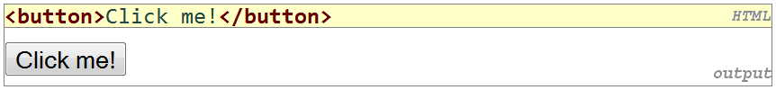
Creating the HTML Control
Buttons <button>:
<!DOCTYPE html PUBLIC “-//W3C//DTD XHTML 1.1//EN”
http://www.w3.org/TR/xhtml11/DTD/xhtml11.dtd>
<html xmlns=http://www.w3.org/1999/xhtml>
<head><title>JavaScript example</title></head>
<body>
<div>
<button>Say the Magic Word</button>
</div>
</body>
</html>
Say the Magic Word

Slide 11
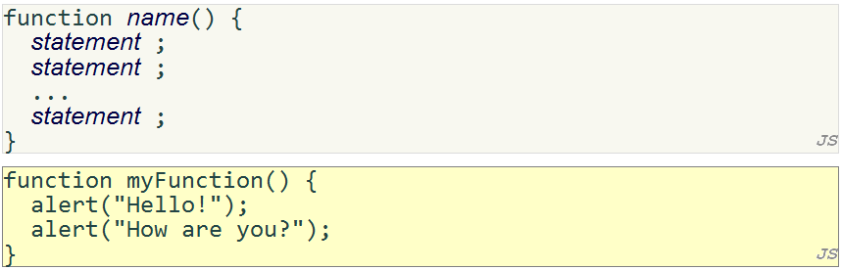
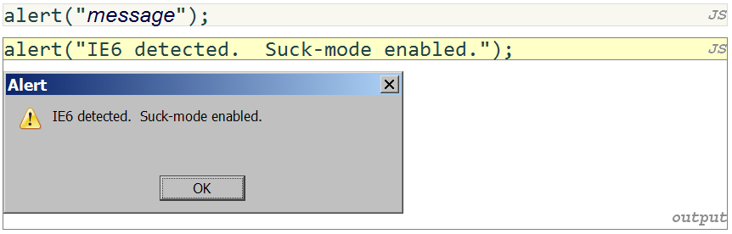
Write JavaScript Event-Handling Function
Notes:
Alert: cause the browser to show a pop-up message dialog box

Slide 12
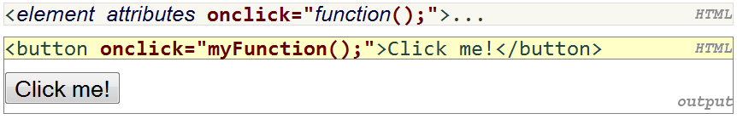

Attach Event Handler to Control
script tag should be placed in HTML page's head
script code is stored in a separate .js file
Event attributes: onclick, onkeydown, onchange, onsubmit
JS code can be placed directly in the HTML file's body or head (bad style)

Slide 13
Attach Event Handler to Control
// please.js
function sayMagicWord() {
alert(“PLEASE!”);
}
<!DOCTYPE html PUBLIC “-//W3C//DTD XHTML 1.1//EN”
http://www.w3.org/TR/xhtml11/DTD/xhtml11.dtd>
<html xmlns=http://www.w3.org/1999/xhtml>
<head>
<title>JavaScript example</title>
<script src=“please.js” type=“text/javascript”></script>
</head>
<body>
<div>
<button onclick=“sayMagicWord();”>Say the Magic Word</button>
</div>
</body>
</html>
Say the Magic Word

Slide 14
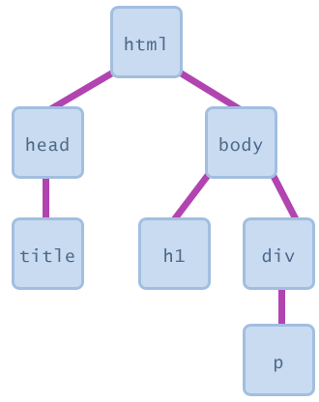
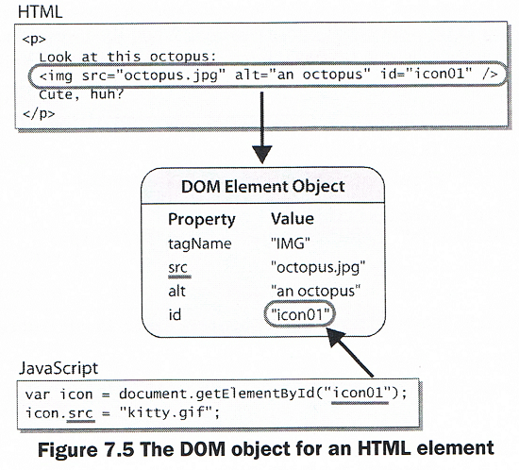
Document Object Model (DOM)
A set of JavaScript objects that represent the content of the current HTML page
most JS code manipulates elements on an HTML page
we can examine the state of the elements, e.g. whether a box is checked
we can change state, e.g. putting text into a div
we can change styles, e.g. make a paragraph red

Slide 15
Accessing DOM Objects by ID
<button onclick=“sayMagicWord();”>Say the Magic Word</button>\
<p id=“result”>What do you say?</p>
What do you say?
Say the Magic Word
function sayMagicWord() {
var paragraph = document.getElementById(“result”);
paragraph.innerHTML = “PLEASE!”;
}
PLEASE!
Say the Magic Word
Notes:
The code does not permanently modify the web page.
innerHTML: represents the text or HTML content inside an element

Slide 16
Self-Check
Page 283

Slide 17
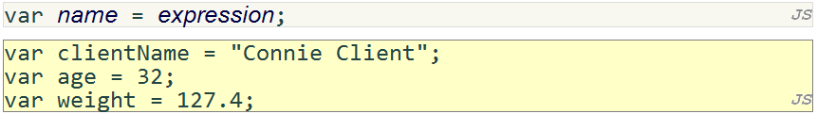
JavaScript Syntax (7.2)
Variables and Types
variables are declared with the var keyword (case sensitive)
types are not specified, but JS does have types ("loosely typed")
Number, Boolean, String, Array, Object, function, null, undefined
can find out a variable's type by calling typeof
Type | Description | Examples
Number | Integer or real number | 42, -17, 3.14, 2.4e-6
Boolean | Logical value | True, false
String | Text string | “Hello there”, ‘how are you’
Array | Indexed list of elements | [12, 17, -5]
Object | Entity containing data and behavior | {name: “Marty”, age: 12}
function | Group of statements to execute | function message() { alert(“Hello, world!”); }
null | An empty value | null
undefined | The lack of a value; an undefined value | undefined
Notes:
Variables are loosely typed
Variables don’t need to be explicitly declared before they are used

Slide 18
JavaScript Syntax - Numbers and Arithmetic
integers and real numbers are the same type (no int vs. double)
same operators: + - * / % ++ -- = += -= *= /= %=
similar precedence to Java
many operators auto-convert types: "2" * 3 is 6

Slide 19
JavaScript Syntax - Comments
identical to Java's comment syntax
recall: 4 comment syntaxes
HTML: <!-- comment -->
CSS/JS/PHP: /* multi-line comment */
Java/JS/PHP: // single-line comment
PHP: # comment

Slide 20
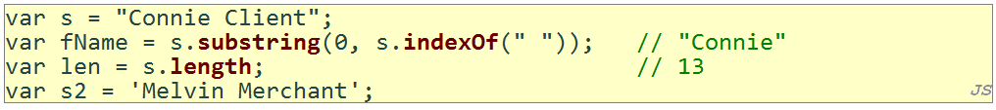
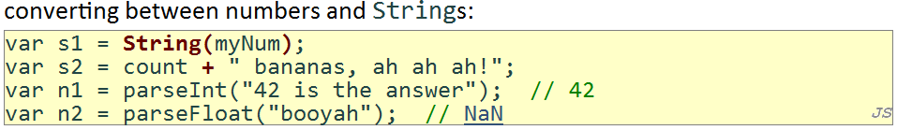
JavaScript Syntax – Strings
methods: charAt, charCodeAt, fromCharCode, indexOf, lastIndexOf, replace, split, substring, toLowerCase, toUpperCase
charAt returns a one-letter String (there is no char type)
length property (not a method as in Java)
Strings can be specified with "" or ''
concatenation with + :
1 + 1 is 2, but "1" + 1 is "11"
escape sequences behave as in Java: \' \" \& \n \t \\

Slide 21
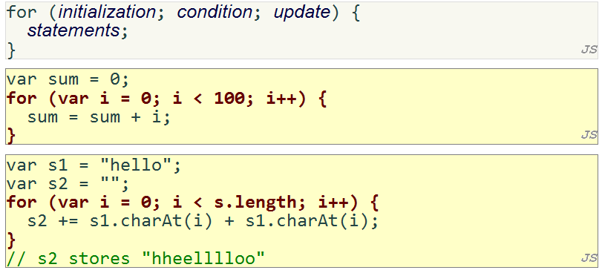
JavaScript Syntax – for loop

Slide 22
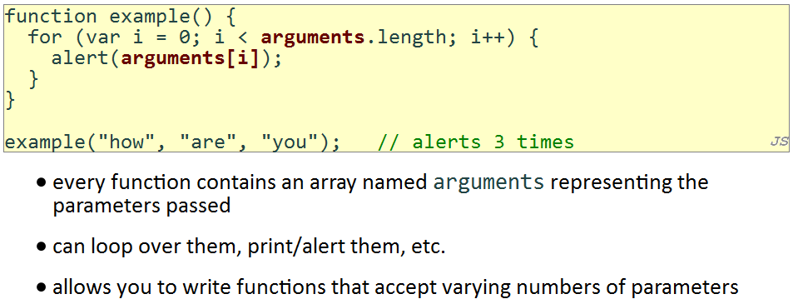
JavaScript Syntax – arguments array

Slide 23
JavaScript Syntax – math Object
methods: abs, ceil, cos, floor, log, max, min, pow, random, round, sin, sqrt, tan
properties: E, PI

Slide 24
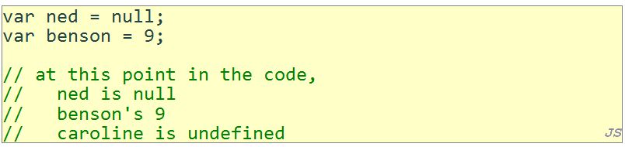
JavaScript Syntax – null and undefined
undefined : has not been declared, does not exist
null : exists, but was specifically assigned a null value

Slide 25
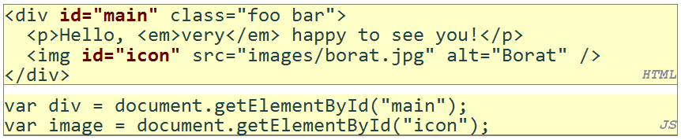
JavaScript Syntax – Using DOM Objects
tagName: element's HTML tag, capitalized;
div.tagName is "DIV"
className: CSS classes of element;
div.className is "foo bar"
innerHTML: HTML content inside element;
div.innerHTML is "\n <p>Hello, <em>very</em> happy to ...
src: URL target of an image;
image.src is "images/borat.jpg"

Slide 26
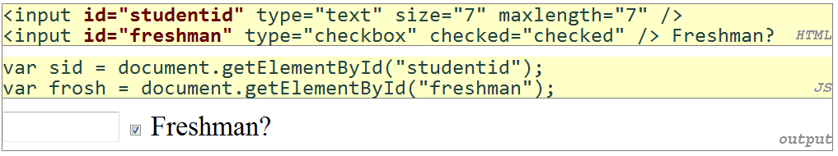
JavaScript Syntax – Using DOM Objects
value: the text in an input control
sid.value could be "1234567"
checked, disabled, readOnly: whether a control is selected/disabled/etc.
frosh.checked is true

Slide 27
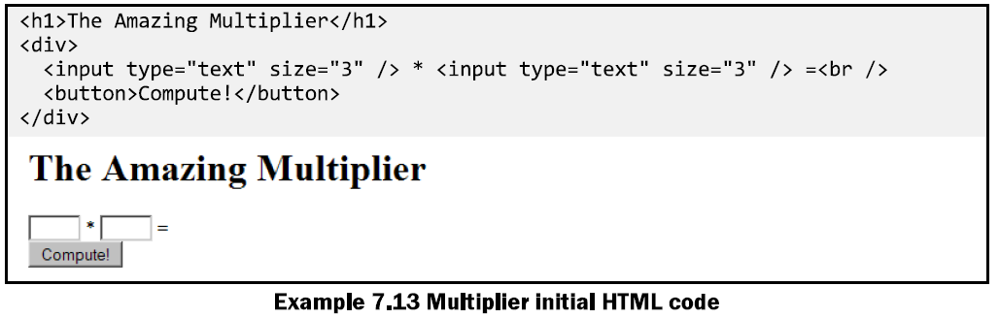
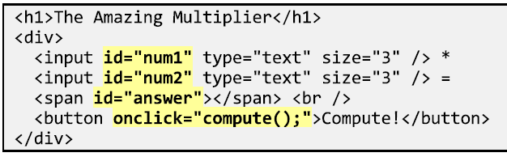
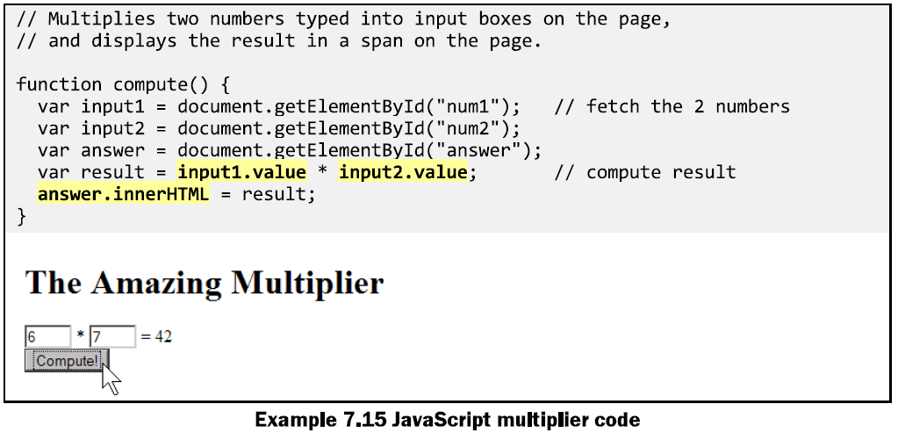
JavaScript Syntax – Using DOM Objects
multiply.js

Slide 28
Document Object Model (DOM)
For more info on DOM Objects, please read Chapter 9
http://www.webstepbook.com/supplements-2ed/slides/chapter09-dom.shtml

Slide 29
Self-Check
Page 305

Slide 30
Program Logic (7.3)
Logic Operators
> < >= <= && || ! == != === !==
most logical operators automatically convert types:
5 < "7" is true
42 == 42.0 is true
"5.0" == 5 is true
=== and !== are strict equality tests; checks both type and value
"5.0" === 5 is false

Slide 31
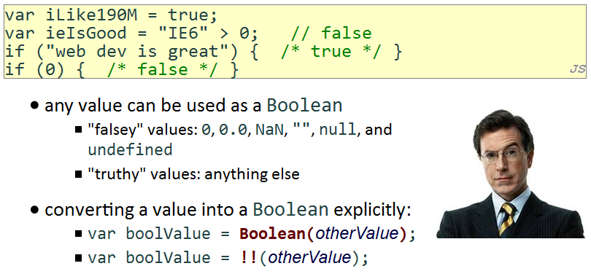
Program Logic – Boolean Values

Slide 32
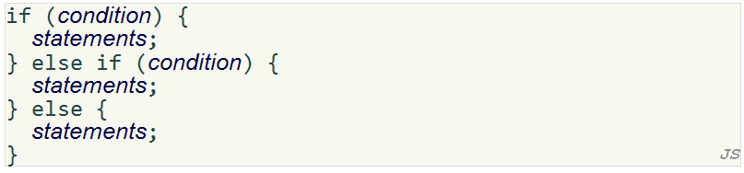
Program Logic – if/else

Slide 33
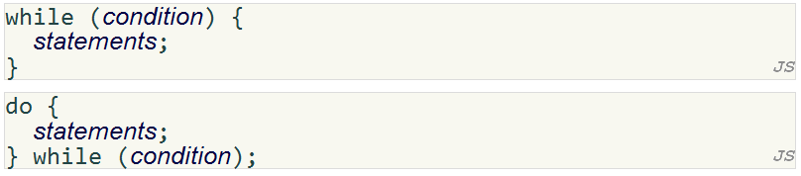
Program Logic – while

Slide 34
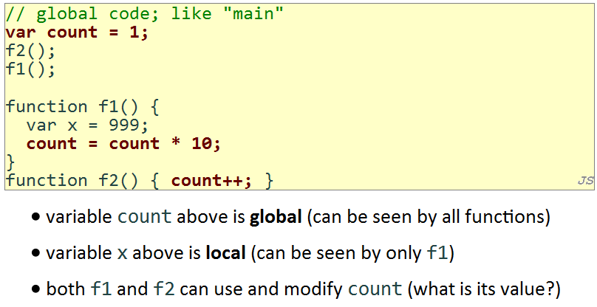
Advanced JavaScript Syntax (7.4)
Scope, global and local variables

Slide 35
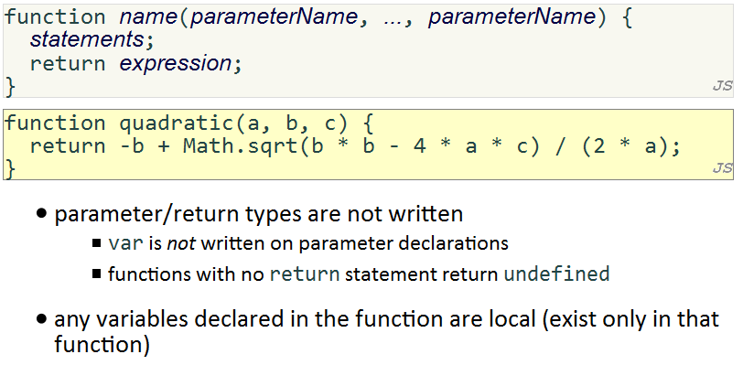
Advanced JavaScript Syntax (7.4)
Function parameters/return

Slide 36
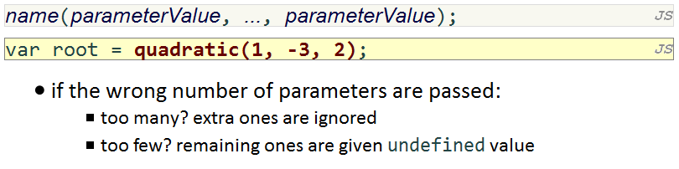
Advanced JavaScript Syntax (7.4)
Calling Functions

Slide 37
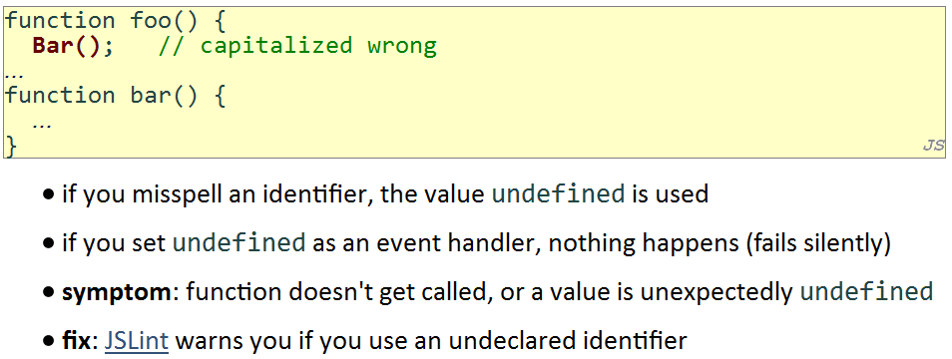
Advanced JavaScript Syntax (7.4)
Common Bug: Spelling Error

Slide 38
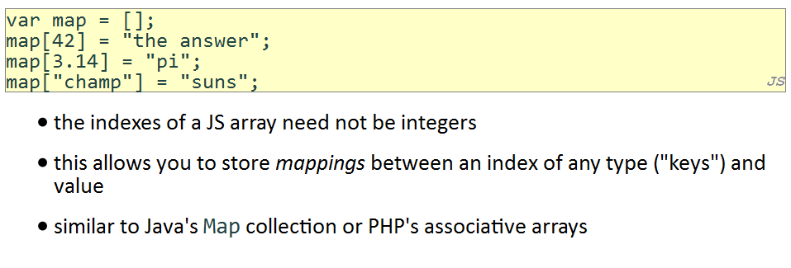
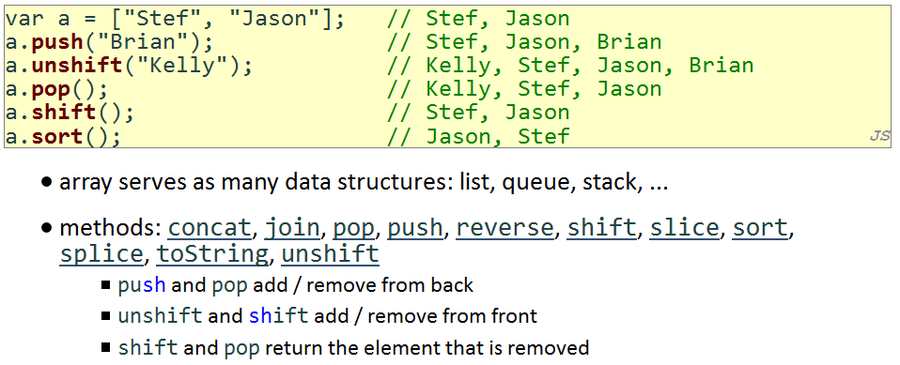
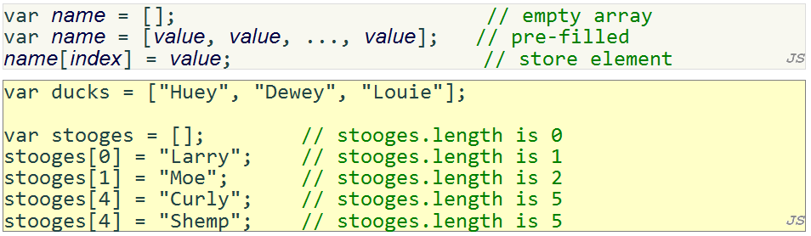
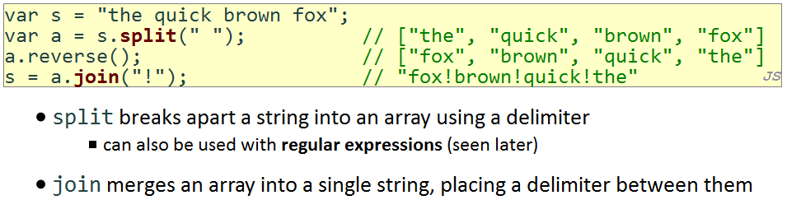
Advanced JavaScript Syntax (7.4)
Arrays

Slide 39
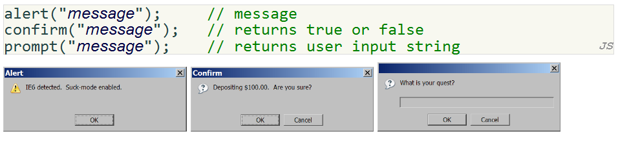
Advanced JavaScript Syntax (7.4)
Popup Boxes

Slide 40
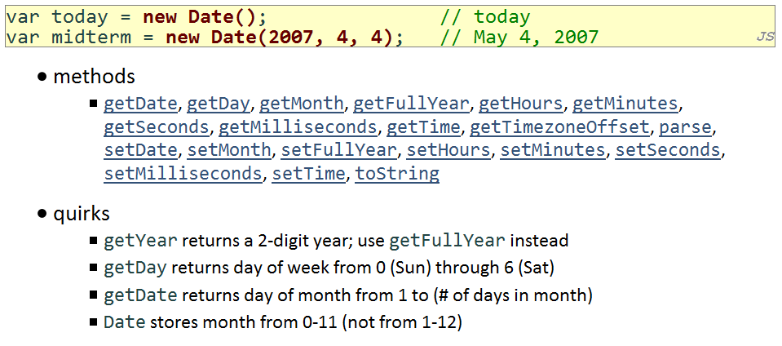
Advanced JavaScript Syntax (7.4)
Date object

Slide 41
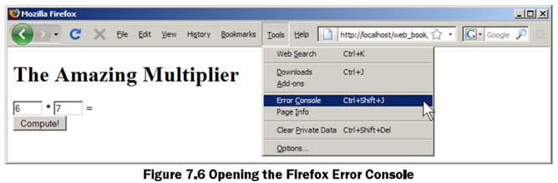
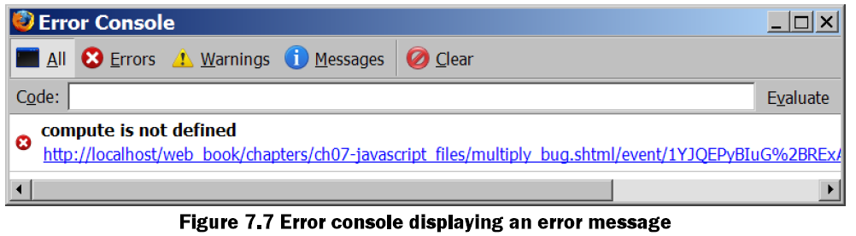
Debugging Common Errors
JavaScript's syntax is looser than Java's, but its errors are meaner

Slide 42
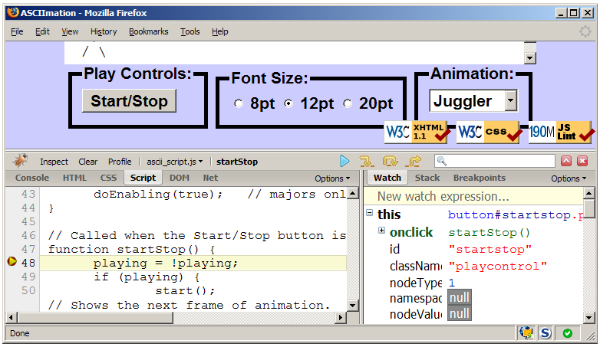
Debugging JS Errors using Firebug

Slide 43
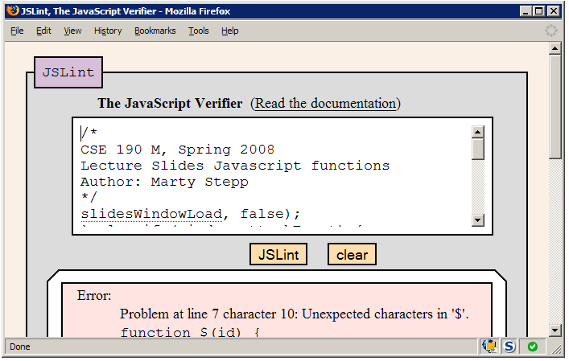
Finding JS Errors using JSLint

Slide 44
Debugging Checklist
Are you sure the browser is even loading your JS file at all? Put an alert at the top of it and make sure it appears.
When you change your code, do a full browser refresh (Shift-Ctrl-R)
Check bottom-right corner of Firefox for Firebug syntax errors.
Paste your code into our JSLint tool to find problems.
Type some test code into Firebug's console or use a breakpoint.

Slide 45
Debugging Checklist
“My program does nothing”
Is the browser even loading my script file?
If so, is it reaching the part of the file that I want it to reach?
If so, what is it doing once it gets there?

Slide 46
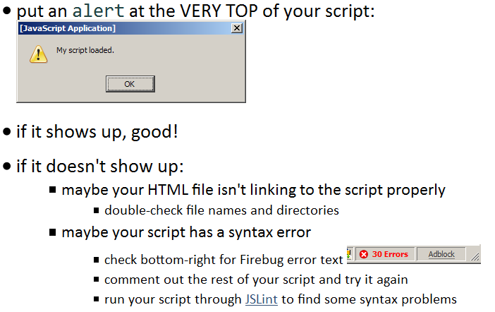
Debugging Checklist
Is my JS file loading?

Slide 47
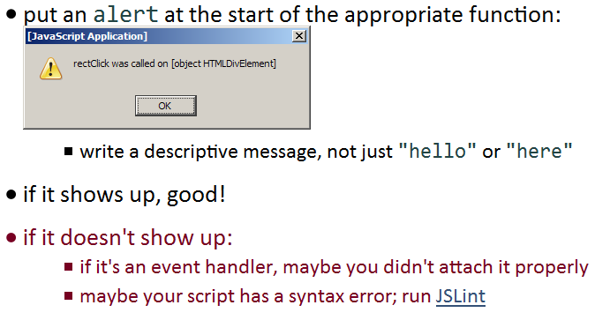
Debugging Checklist
Is it reaching the code I want it to run?

Slide 48
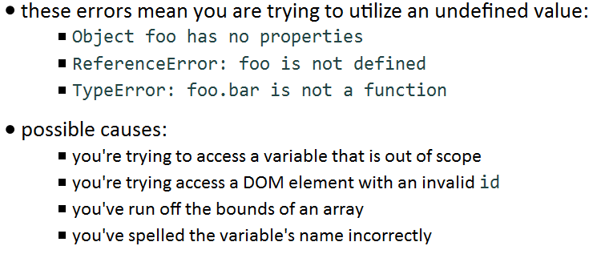
Debugging Checklist
Object 'foo' has no properties

Slide 49
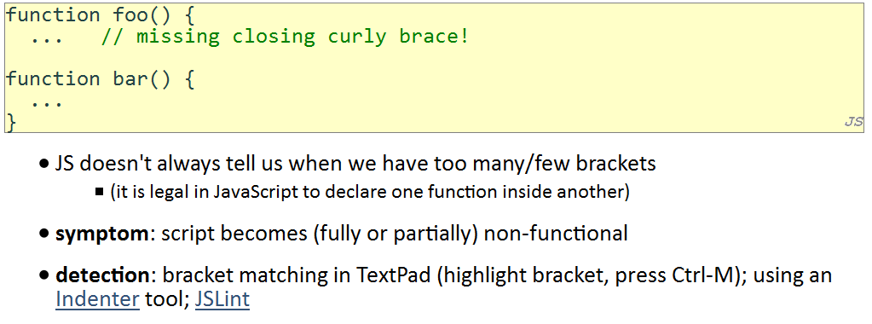
Debugging Checklist
Common bug: bracket mismatches

Slide 50
Self-Check
Page 321
Reading Assignment:
Ch 8.5 Case Study: Hangman
http://www.pacificescience.com/jgao/COMP127/code/ch08-javascript/hangman5.html

Slide 51
Summary
JavaScript vs. Java vs. PHP
JavaScript Syntax

